Slide 1
The Medium Access Control Sublayer
Chapter 4

Slide 2
Channel Allocation Problem
Static channel allocation
Assumptions for dynamic

Slide 3
Assumptions for Dynamic Channel Allocation
Independent traffic
Single channel
Observable Collisions
Continuous or slotted time
Carrier sense or no carrier sense

Slide 4
Multiple Access Protocols
ALOHA (Hawaii in early 1970s)
Carrier Sense Multiple Access
Collision-free protocols
Limited-contention protocols
Wireless LAN protocols

Slide 5
Contention
Systems in which multiple users share a common channel in a way that can lead to conflicts are known as contention systems.
A frame will not suffer a collision if no other frames are sent within one frame time of its start.

Slide 6
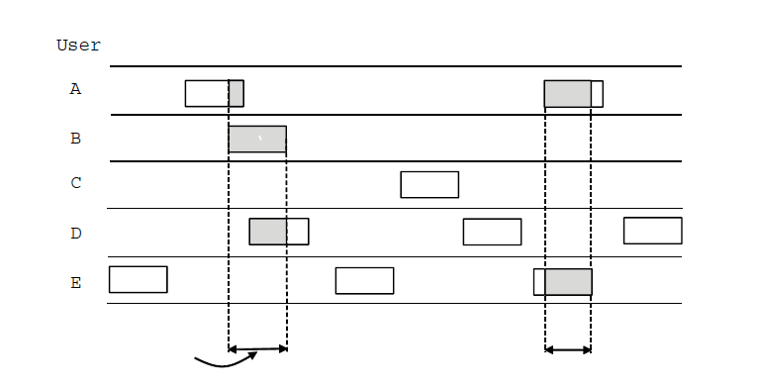
ALOHA (1)
User
A
B
C
D
E
Collision
Collision
Time
In pure ALOHA, frames are transmitted
at completely arbitrary times

Slide 7
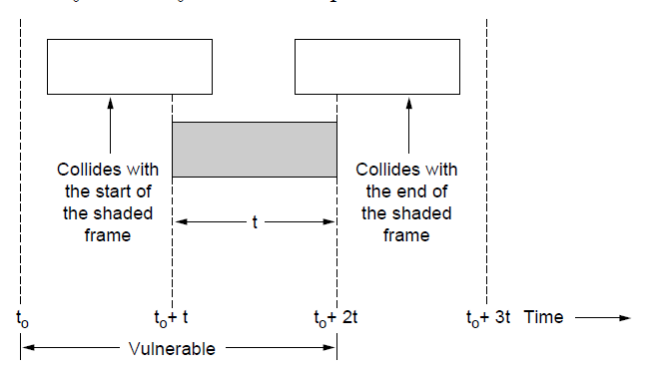
ALOHA (2)
Vulnerable period for the shaded frame.

Slide 8
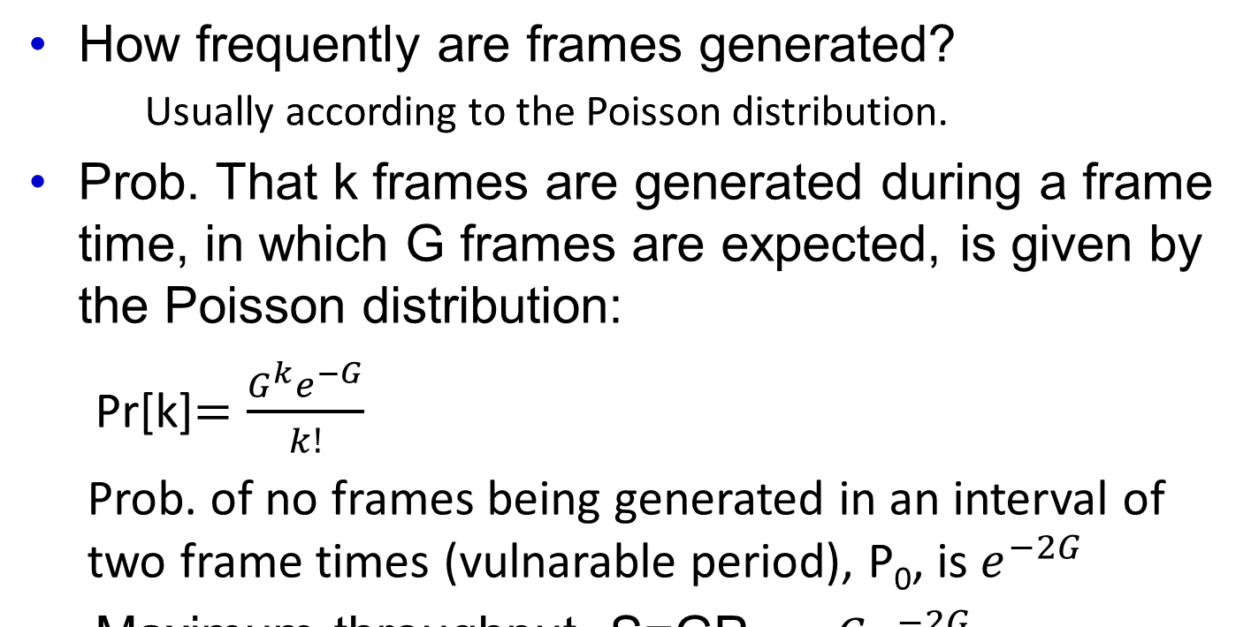
ALOHA

Slide 9
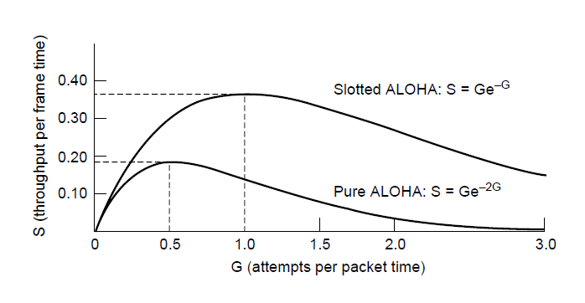
ALOHA (3)
Throughput versus offered traffic for ALOHA systems.

Slide 10
Carrier Sense Multiple Access (CSMA) Protocols
1-persistent CSMA
When the station has data to send, first listens to the channel
If the channel is idle, the station sends its data
If the channel is busy, the station waits until it becomes idle. Then transmits a frame.
If a collision occurs, the station waits for a random amount of time and starts all over again.

Slide 11
Nonpersistent CSMA
If the station finds the channel busy, it waits a random period of time then repeats.
Nonpersistent CSMA gives better channel utilization but longer delays.
p-persistent CSMA:
If the station finds the channel idle, it transmits with probability p. With probability (1-p) it defers until the next slot. If that slot is idle, it transmits or defers again

Slide 12
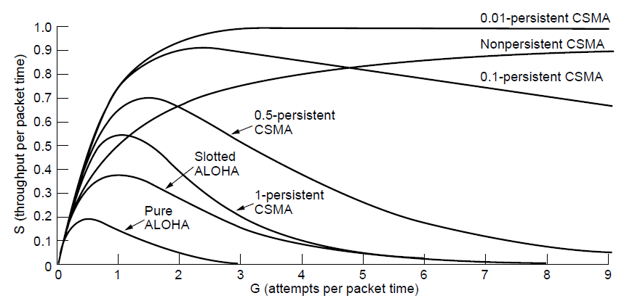
Persistent and Nonpersistent CSMA
Comparison of the channel utilization versus load for various random access protocols.

Slide 13
CSMA with Collision Detection
In CSMA, if two stations sense the channel to be idle at the same time and begin transmitting simultaneously, their signals will collide. Another improvement. They should stop transmitting as soon as they detect the collision. It saves time and bandwidth.
It is called CSMA/CD.
Detecting the collision, the station aborts its transmission, waits for a random period of time and tries again.

Slide 14
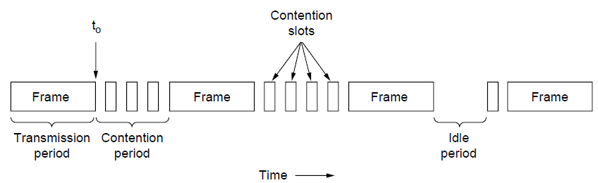
CSMA with Collision Detection
CSMA/CD can be in one of three states: contention, transmission, or idle.

Slide 15
CSMA with Collision Detection
Consider the following worst scenario case: the propagation time between two farthest stations is τ . Then the collision may not be felt for a duration of 2τ−ε. Hence the station must be transmitting for a period of 2τ.

Slide 16
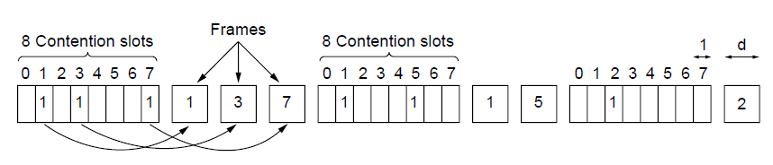
Collision-Free Protocols (1)
Reservation protocols.
The basic bit-map protocol.

Slide 17
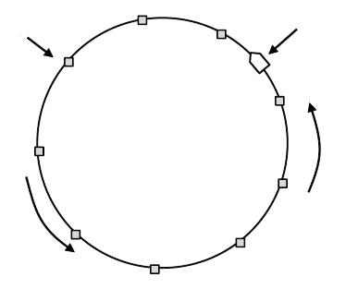
Collision-Free Protocols (2)
Token
Station
Direction of
transmission
Token ring.

Slide 18
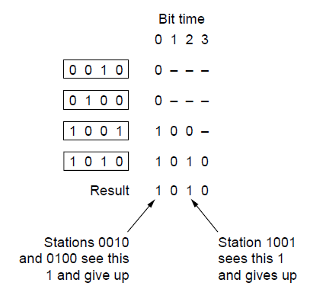
Binary Countdown - SKIP
The binary countdown protocol. A dash indicates silence.

Slide 19
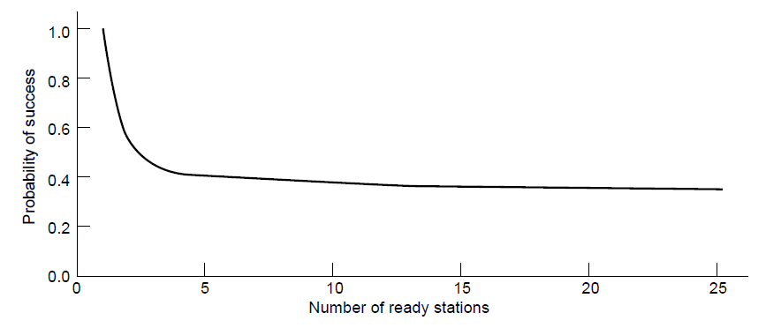
Limited-Contention Protocols - SKIP
Acquisition probability for a symmetric contention channel.

Slide 20
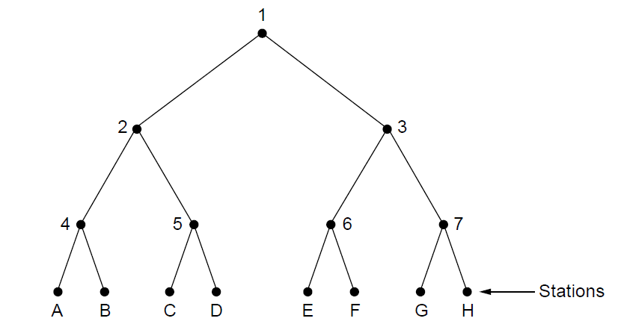
The Adaptive Tree Walk Protocol - SKIP
The tree for eight stations

Slide 21
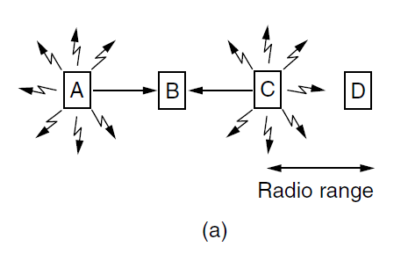
Wireless LAN Protocols (1)
A wireless LAN. (a) A and C are hidden terminals
when transmitting to B.

Slide 22
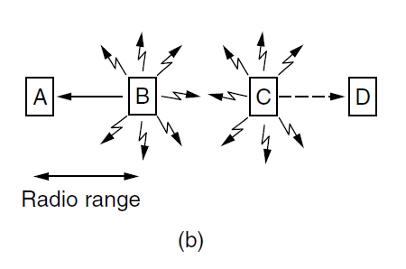
Wireless LAN Protocols (2)
A wireless LAN. (b) B and C are exposed terminals when transmitting to A and D.

Slide 23
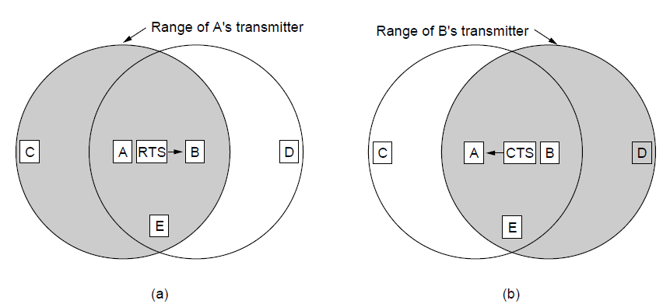
Wireless LAN Protocols (3)
The MACA protocol. (a) A sending an RTS to B. (b) B responding with a CTS to A.

Slide 24
Ethernet
Physical layer
MAC sublayer protocol
Ethernet performance
Switched Ethernet
Fast Ethernet
Gigabit Ethernet
10 Gigabit Ethernet
IEEE 802.2: Logical Link Control
Retrospective on Ethernet

Slide 25
Two kinds of Ethernet
Classical Ethernet (3 – 10 Mbps)
Switched Ethernet (100, 1000, 10000 Mbps)
In practice, only switched Ethernet is used nowadays

Slide 26
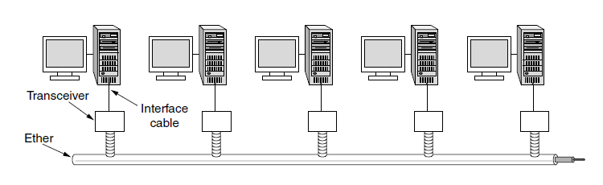
Classic Ethernet Physical Layer
Architecture of classic Ethernet
To allow larger networks, multiple cables can be connected by repeaters.
Each segment can be at most 500 m long.
No two transceivers could be more than 2.5 km apart.

Slide 27
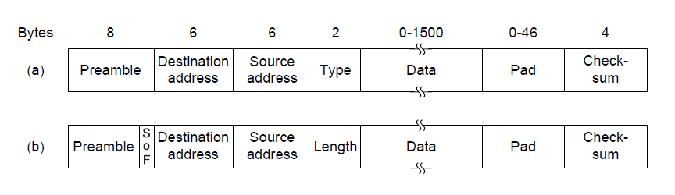
MAC Sublayer Protocol (1)
Preamble of 8 bytes:10101010 ... 1010101011 (synchronizes receiver
clock with the sender’s)
The number in Length which is less than 1536 is interpreted as length,
otherwise type.
Frame formats. (a) Ethernet (DIX, developed by DEC, Intel, and Xerox in1978). (b) IEEE 802.3 (in 1983).

Slide 28
MAC Sublayer Protocol (1.5)
Ethernet requires that valid frames must be at least 64 bytes long, from destination address to checksum (including both). The Pad field is used to fill out the frame to the minimum size.
What is the reason behind the mininun frame size?

Slide 29
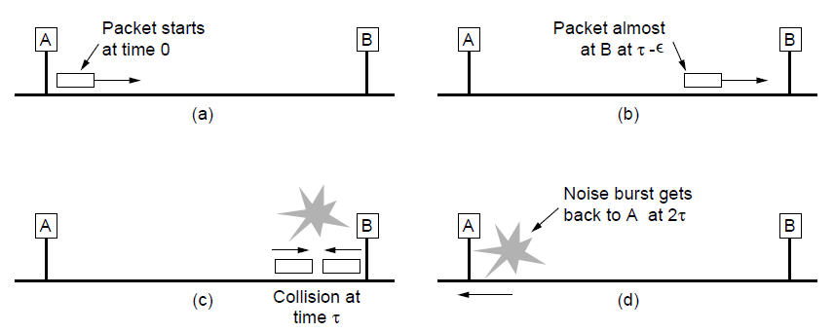
MAC Sublayer Protocol (2)
Collision detection can take as long as 2τ.

Slide 30
MAC Sublayer Protocol (2.5)
For an 10 Mbps LAN with max length of 2500 meters, propagation delay is 50 μsec in the worst case.
Means 500 bits. Leading 64 Bytes (64 x 8 = 512)

Slide 31
CSMA/CD with The Binary Exponential Backoff Algorithm
If there is a collision, they abort transmission and retransmit after a random interval.
To accommodate the longest path by Ethernet, the slot time has been set to 512-bit time, or 51.2 μsec.
After i collisions a new random number in the range of (0 – (2^{i}-1)) is selected to decide about the number slots to be skipped.
After 10 collisions i remains the same, after 16 collisions, the controller reports a failure.

Slide 32
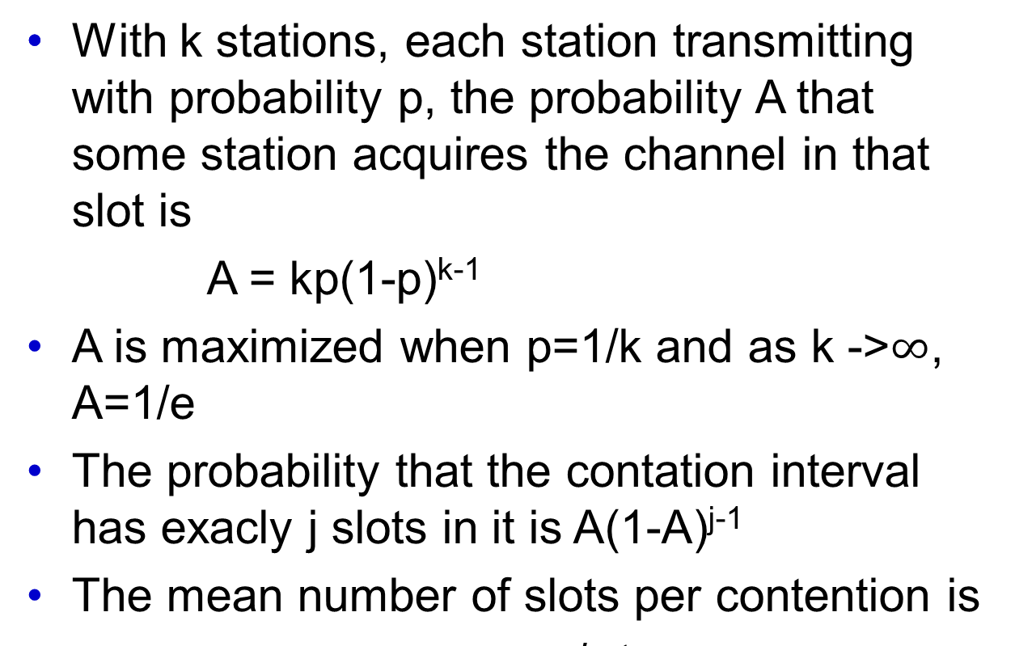
Ethernet Performance

Slide 33
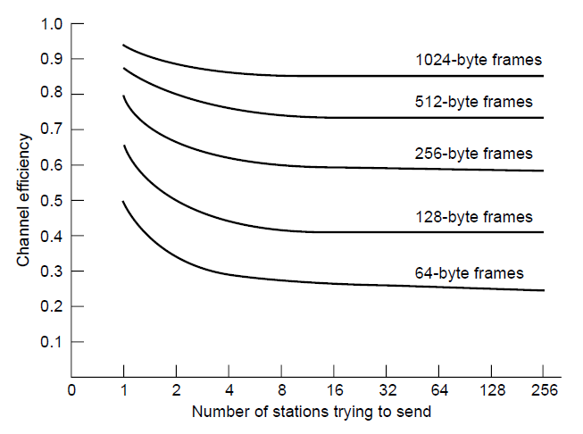
Ethernet Performance
Efficiency of Ethernet at 10 Mbps with 512-bit slot times.

Slide 34
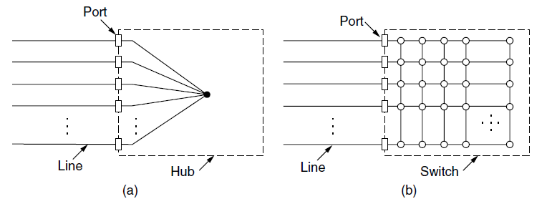
Switched Ethernet (1)
(a) Hub. (b) Switch.
Switches only output frames to the ports for which those frames are destined.
Collisions are impossible.
In a hub, all stations are in the same collision domain.
Most LAN interfaces have a promiscous mode.

Slide 35
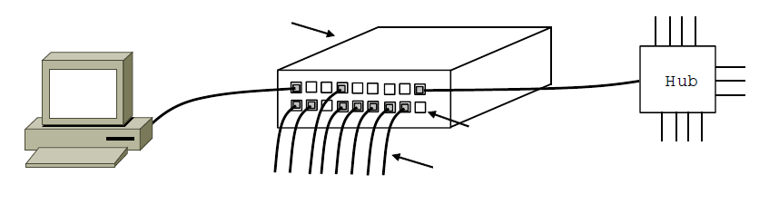
Switched Ethernet (2)
Switch
Hub
Switch ports
Twisted pair
An Ethernet switch.

Slide 36
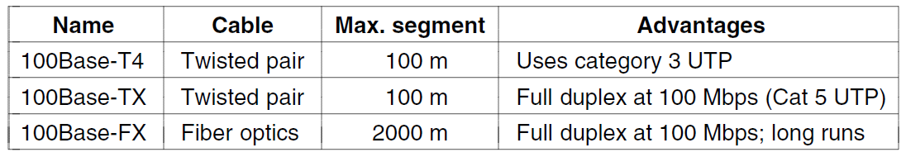
Fast Ethernet - READ
The original fast Ethernet cabling.

Slide 37
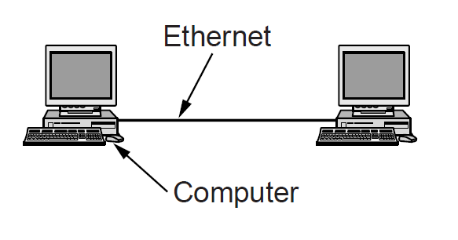
Gigabit Ethernet (1) - READ
A two-station Ethernet

Slide 38
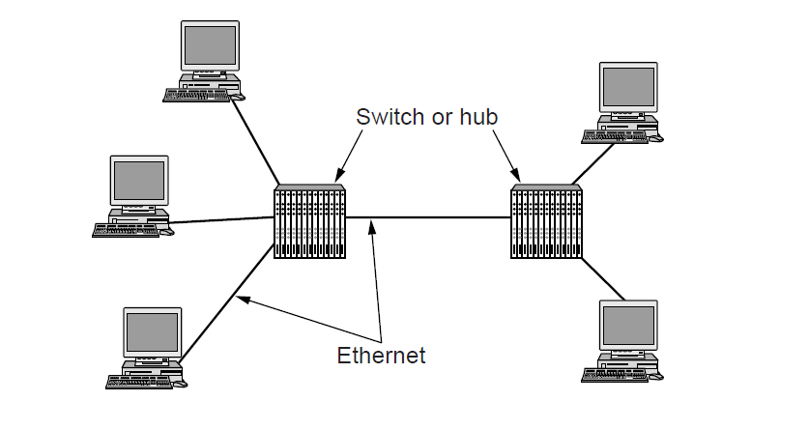
Gigabit Ethernet (2) - READ
A two-station Ethernet

Slide 39
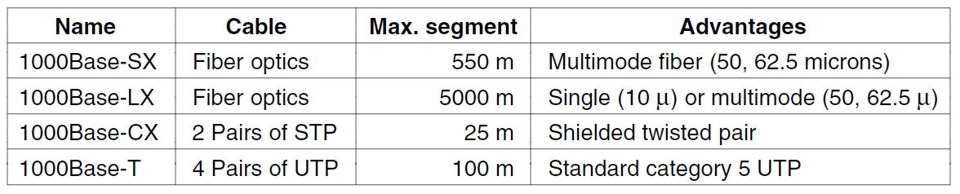
Gigabit Ethernet (3) - READ
Gigabit Ethernet cabling.

Slide 40
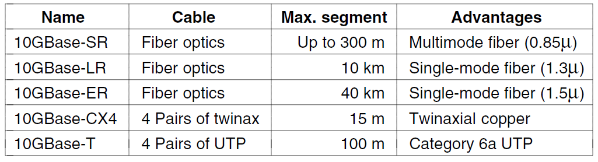
10 Gigabit Ethernet - READ
Gigabit Ethernet cabling

Slide 41
Wireless LANs
802.11 architecture and protocol stack
802.11 physical layer
802.11 MAC sublayer protocol
802.11 frame structure
Services

Slide 42
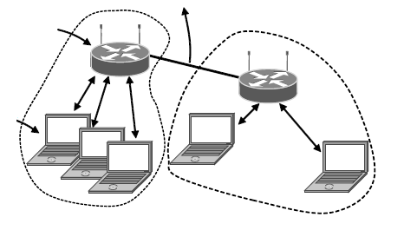
802.11 Architecture and Protocol Stack (1)
To Network
Access
Point
Client
802.11 architecture – infrastructure mode

Slide 43
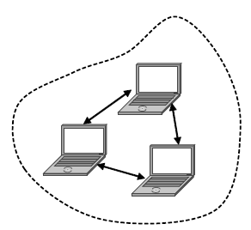
802.11 Architecture and Protocol Stack (2)
802.11 architecture – ad-hoc mode

Slide 44
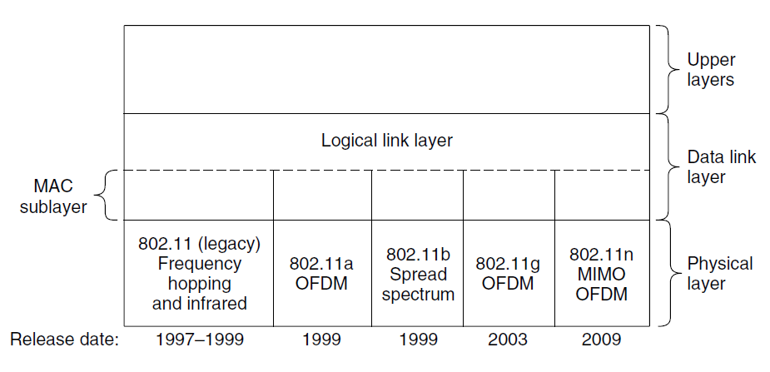
802.11 Architecture and Protocol Stack (3)
Part of the 802.11 protocol stack.

Slide 45
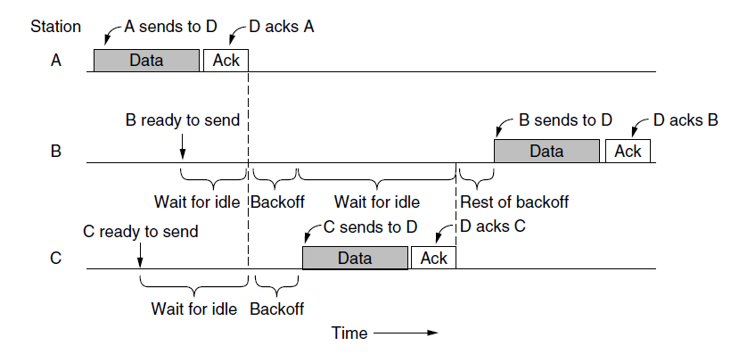
The 802.11 MAC Sublayer Protocol (1)
Sending a frame with CSMA/CA.

Slide 46
The 802.11Operation Modes
DCF (Distributed Coordination Function)
PCF (Point Coordination Function)

Slide 47
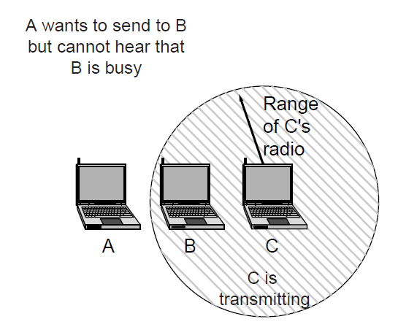
The 802.11 MAC Sublayer Protocol (2)
The hidden terminal problem.

Slide 48
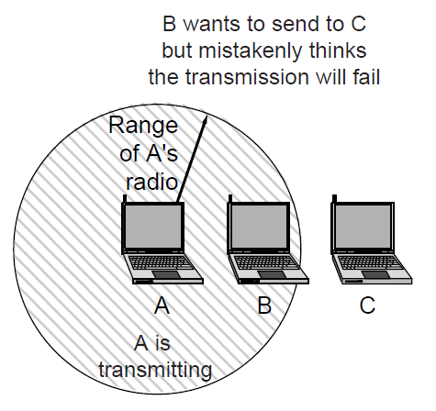
The 802.11 MAC Sublayer Protocol (3)
The exposed terminal problem.

Slide 49
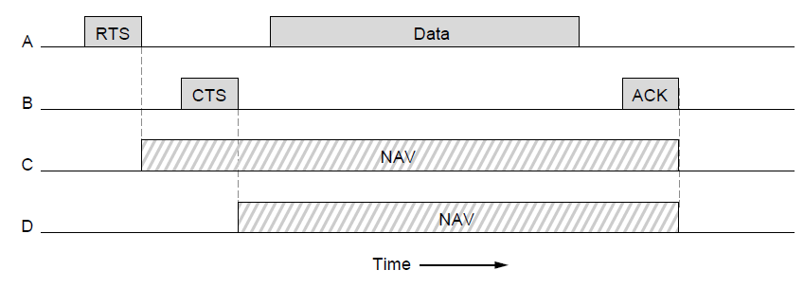
The 802.11 MAC Sublayer Protocol (4)
NAV – Network Allocation Vector
The use of virtual channel sensing using CSMA/CA.

Slide 50
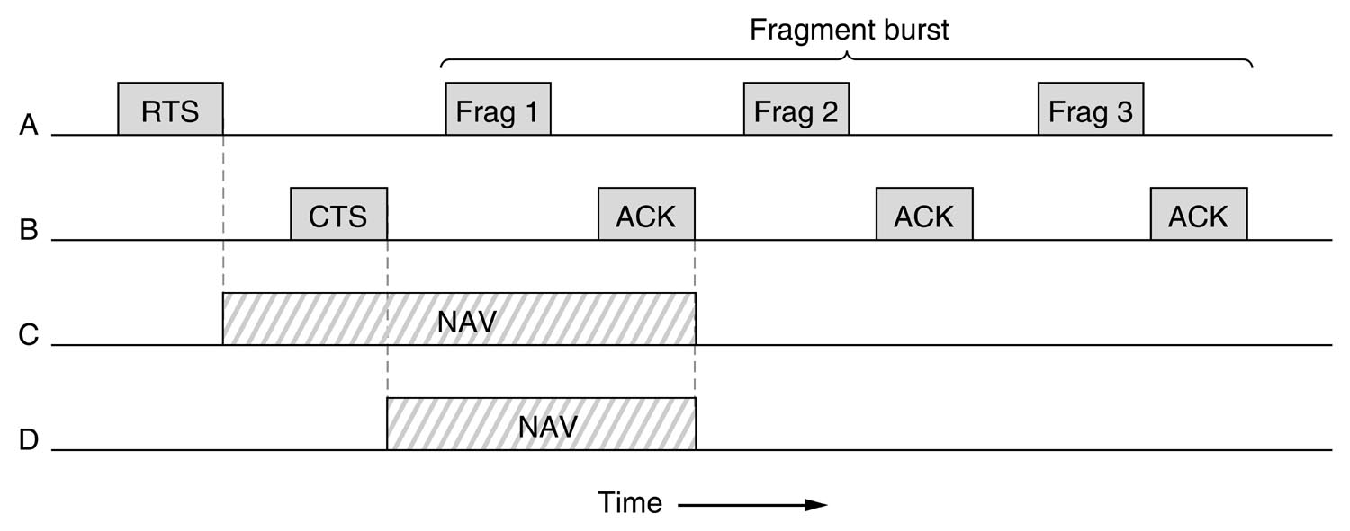
A fragment burst

Slide 51
The 802.11 MAC Sublayer Protocol
Beacon frames are broadcast periodicaly by the AP to advertise the presence of it to clients and carry system parameters.

Slide 52
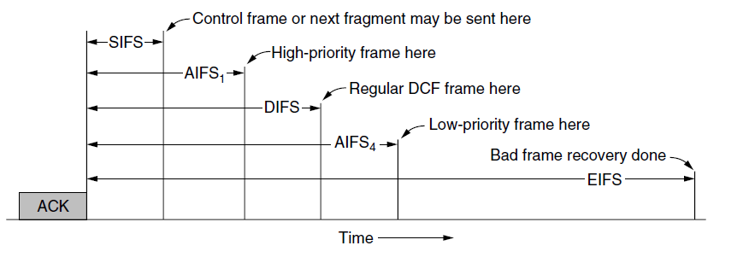
The 802.11 MAC Sublayer Protocol (5)
SIFS- Short Interframe Spacing
AIFS- Artbitration Interframe Spacing
DIFS- DCF Interframe Spacing
EIFS- Extended Interframe Spacing
Interframe spacing in 802.11

Slide 53
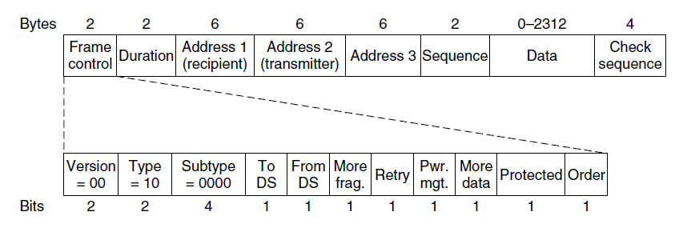
802.11 Frame Structure
Format of the 802.11 data frame

Slide 54
Broadband Wireless - SKIP
Comparison of 802.16 with 802.11, 3G
802.16 architecture and protocol stack
802.16 physical layer
802.16 frame structure

Slide 55
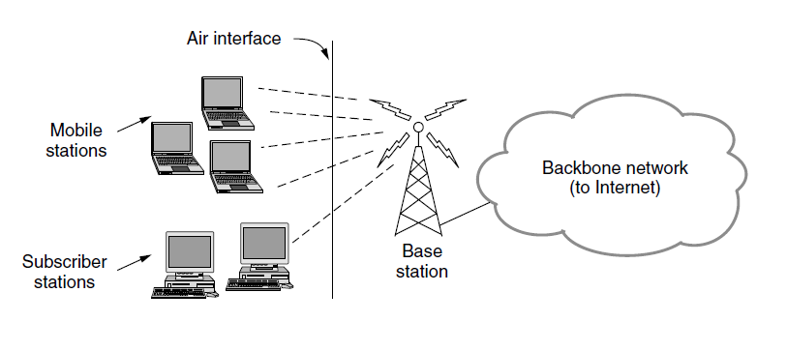
Comparison of 802.16 with 802.11 and 3G - SKIP
The 802.16 architecture

Slide 56
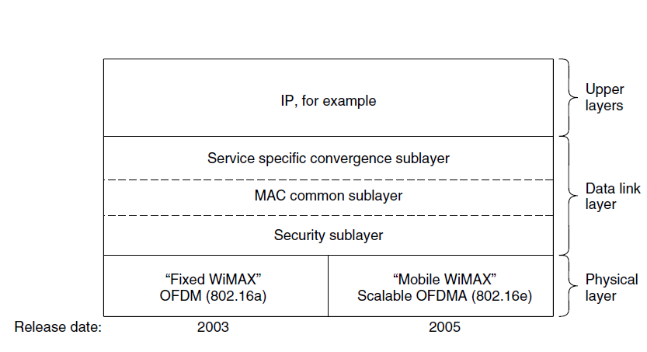
802.16 Architecture and Protocol Stack - SKIP
The 802.16 protocol stack

Slide 57
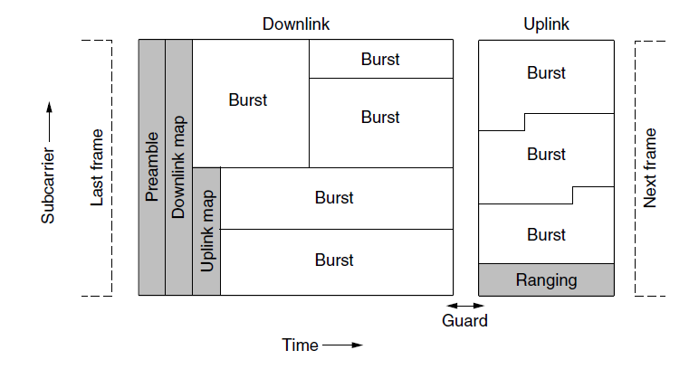
802.16 Physical Layer - SKIP
Frames structure for OFDMA with time division duplexing.

Slide 58
802.16 MAC Sublayer Protocol -SKIP
Classes of service
Constant bit rate service.
Real-time variable bit rate service.
Non-real-time variable bit rate service.
Best-effort service.

Slide 59
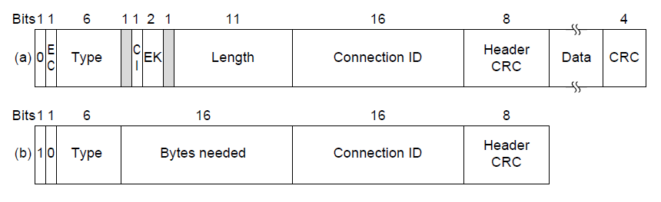
802.16 Frame Structure - SKIP
(a) A generic frame. (b) A bandwidth request frame.

Slide 60
Bluetooth - SKIP
Architecture
Applications
Protocol stack
Radio layer
Link layers
Frame structure

Slide 61
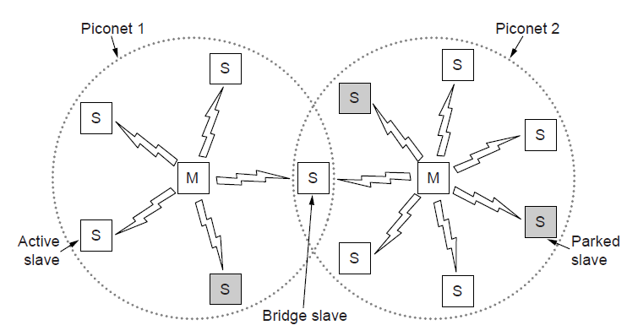
Bluetooth Architecture -SKIP
Two piconets can be connected to form a scatternet

Slide 62
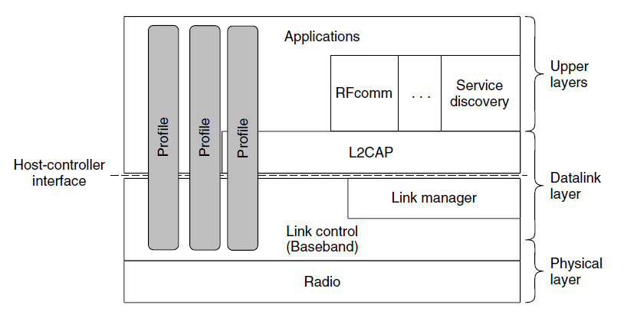
Bluetooth Protocol Stack - SKIP
The Bluetooth protocol architecture.

Slide 63
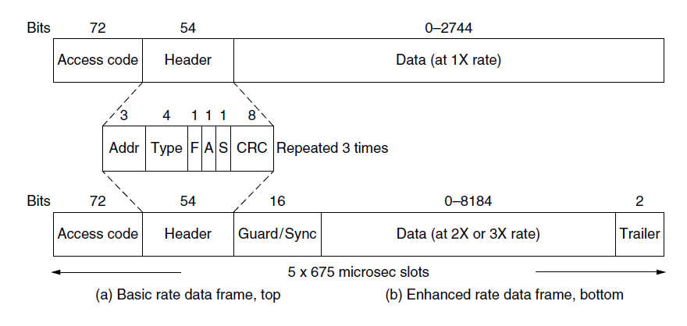
Bluetooth Frame Structure - SKIP
Typical Bluetooth data frame at (a) basic, and
(b) enhanced, data rates.

Slide 64
RFID - SKIP
EPC Gen 2 architecture
EPC Gen 2 physical layer
EPC Gen 2 tag identification layer
Tag identification message formats

Slide 65
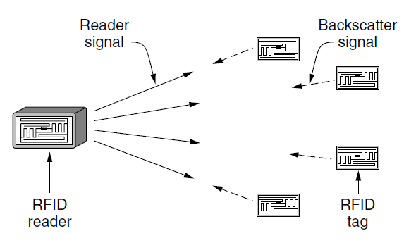
EPC Gen 2 Architecture - SKIP
RFID architecture.

Slide 66
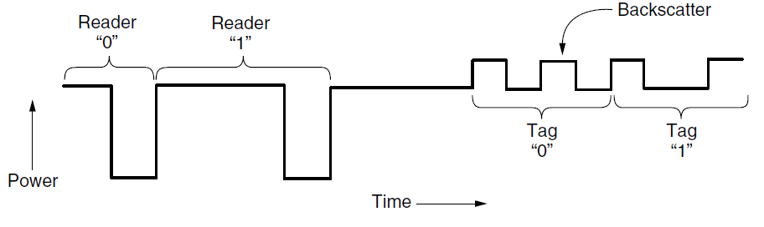
EPC Gen 2 Physical Layer - SKIP
Reader and tag backscatter signals.

Slide 67
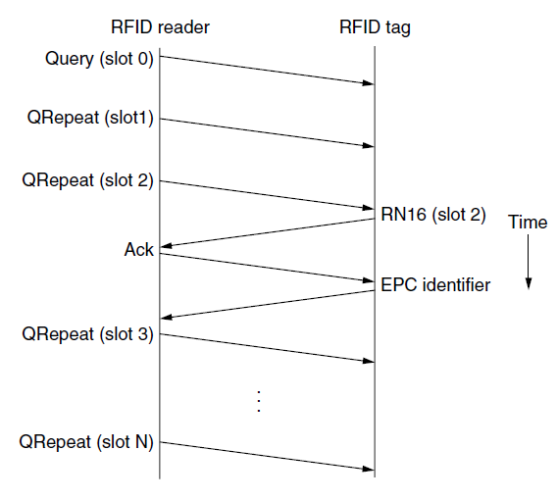
EPC Gen 2 Tag Identification Layer - SKIP
Example message exchange to identify a tag.

Slide 68
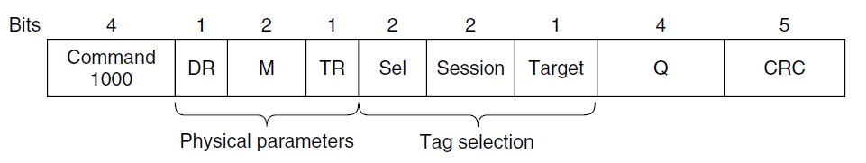
Tag Identification Message Formats - SKIP
Format of the Query message.

Slide 69
Data Link Layer Switching
Uses of bridges
Learning bridges
Spanning tree bridges
Repeaters, hubs, bridges, switches, routers, and gateways
Virtual LANs

Slide 70
Common reasons for bridges
Multiple LANS due to:
  Different owners for each (departments in a university)
  Large geographic distances between distant machines. Multiple LANS
    Lower cost
    Reduce propogation delay, make operation feasible
  Accommodate load.
Bridges:
  Selective forwarding by bridges
    Reliability
    Security

Slide 71
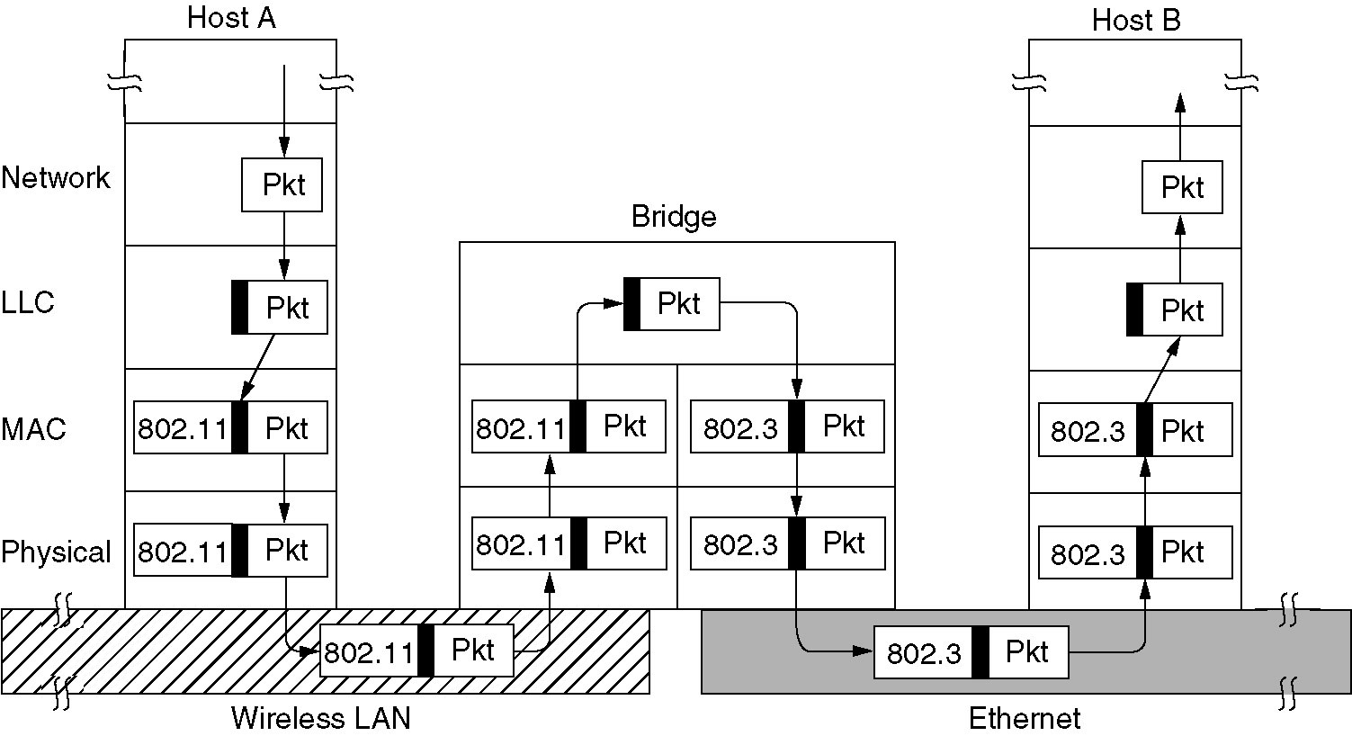
Bridges from 802.x to 802.y
Operation of a LAN bridge from 802.11 to 802.3.

Slide 72
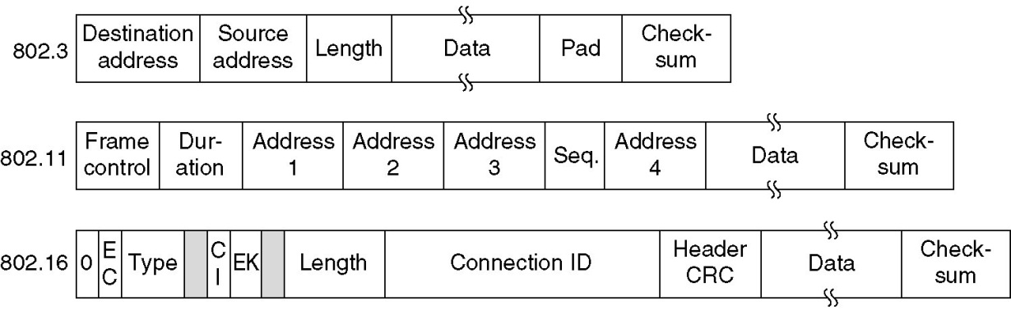
Problems of bridging
Frame format translation (Different formats for different needs)
Different data rates
  Fast LAN feeding a slow LAN
  Multiple LANS feeding a single one
Different maximum frame lengths (no splitting possible)
Encryption may or may not be supported (No way to decrypt a frame encrypted by 802.11 at the receiving end of 802.3)
  Encryption may be performed at a higher layer
Lower QOS over 802.3 than 802.11 or 802.16

Slide 73
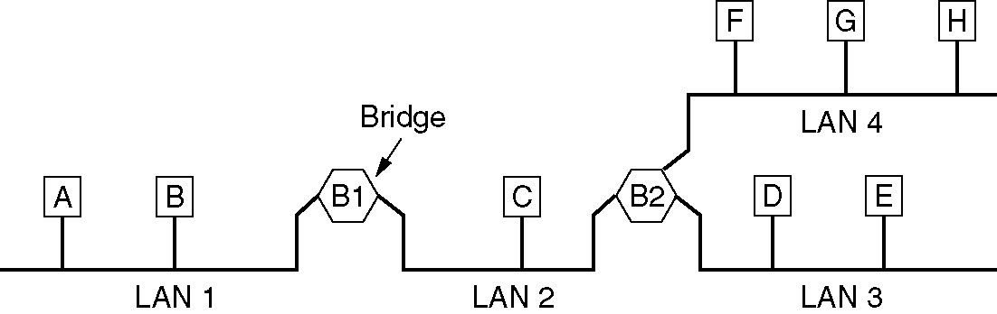
Local Internetworking
A configuration with four LANs and two bridges.

Slide 74

Learning Bridges (1)
Bridge connecting two multidrop LANs

Slide 75

Learning Bridges (2)
Bridges (and a hub) connecting seven point-to-point stations.

Slide 76

Learning Bridges (3)
Protocol processing at a bridge.

Slide 77
Backward Learning
  Accept every frame on all the LANS to which it is attached
  Forward a frame if only source and destination LANS are different
  For an unknown destination flood a frame on all LANs except the one it came from
  Keep hash tables to record over which LAN each 802.x user can be reached.
    Initially tables entries for all destinations are empty
    Hash tables can be filled by backward learning algorithm
      Record which LAN each frame comes from and use this info for forwarding
  Cut-through switching: start processing header info before the complete frame received!

Slide 78
Dynamic topologies
Record/Update the arrival time of the last frame from a source.
Remove old entries more than a few minutes old
A machine can be moved around the interconnected LANS.

Slide 79
Loops and spanning trees

Slide 80

Spanning Tree Bridges (1)
Bridges with two parallel links

Slide 81

Spanning Tree Bridges (2)
A spanning tree connecting five bridges. The dotted lines are links that are not part of the spanning tree.

Slide 82
Poem by Radia Perlman (1985)
Algorithm for Spanning Tree (1) - ☺
I think that I shall never see
A graph more lovely than a tree.
A tree whose crucial property
Is loop-free connectivity.
A tree which must be sure to span.
So packets can reach every LAN.
. . .

Slide 83
Poem by Radia Perlman (1985)
Algorithm for Spanning Tree (2) - ☺
. . .
First the Root must be selected
By ID it is elected.
Least cost paths from Root are traced
In the tree these paths are placed.
A mesh is made by folks like me
Then bridges find a spanning tree.

Slide 84

Repeaters, Hubs, Bridges, Switches, Routers, and Gateways
(a) Which device is in which layer.
(b) Frames, packets, and headers.

Slide 85
Network switching elements
Repeater: Passive copy of signal from one line to another with amplification
Hub: Passive copy of signal from incoming line to all other lines without amplification (collision domain)
Bridge: Interconnect two LAN’s at the data link layer.
  Table look-up based on destination address.
  Line card for each different network type and speed forms a collision domain.
Switch: Interconnect multiple computers at the data link layer.
  No collisions, but packet discard due to buffer fullness.

Slide 86

Virtual LANs (1)
A building with centralized wiring using hubs and a switch.

Slide 87
Splitting a LAN into multiple LAN’s
Group users (one hub for each group) with different
  Organizational interests
  Security needs
  Capacity needs
Broadcast results in capacity to increase linearly with number of machines
  Broadcast storms (multiple small size LAN’s separated by bridges could be a soln)

Slide 88

Virtual LANs (2)
Two VLANs, gray and white, on a bridged LAN.

Slide 89

The IEEE 802.1Q Standard (1)
Bridged LAN that is only partly VLAN-aware. The shaded symbols are VLAN aware. The empty ones are not.

Slide 90

The IEEE 802.1Q Standard (2) - READ
The 802.3 (legacy) and 802.1Q Ethernet frame formats.

Slide 91
End
Chapter 4

